Slide 1



Vaillant Service – Pobl Housing Association

Slide 2

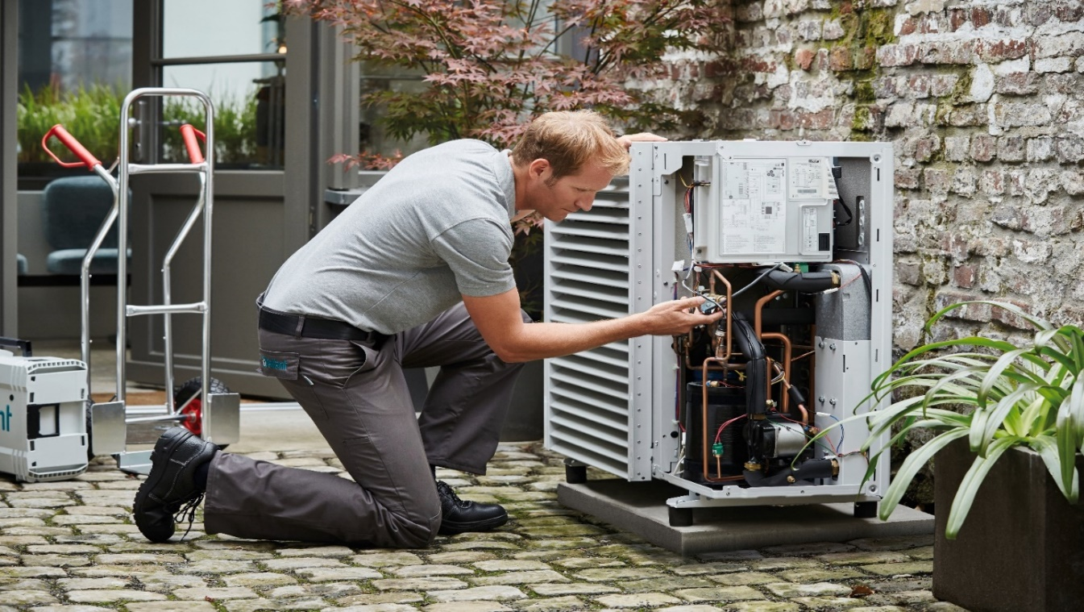

Service & Support
Delivering complete peace of mind
We are here to help support:
Dedicated renewables contact centre support team
Nationwide dedicated engineer support network
Products & Services
Annual Servicing
First commissioning
Annual function checks
Breakdowns & repairs
Spare parts
Extended guarantee packages available for new installs
For further information
Call us on : 0330 1003540
Email : aftersales-uk@vaillant-group.com

Slide 3
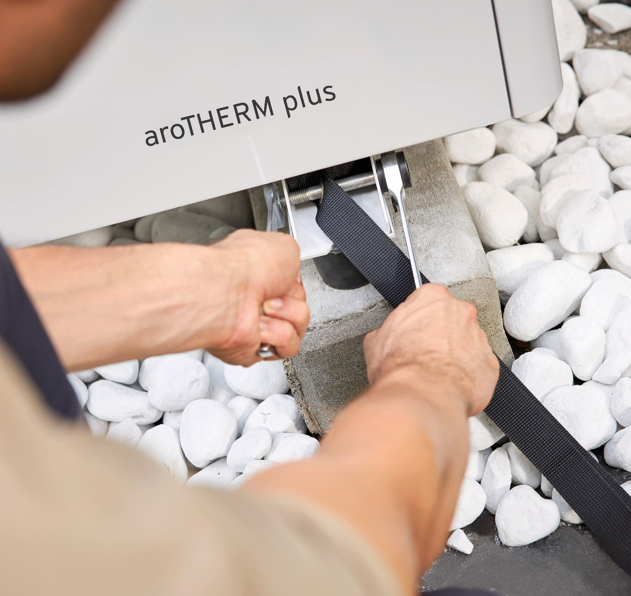
Homeowner Package : Guarantee & Servicing
10 Year Cover and Care Packages : 2+8
Pobl -
AFC : £225 Per Appliance EXC VAT
Customer Offering -
10 year manufacturer guarantee
9 Annual services
£2,250 (One off payment). INC VAT
9 annual payments of £250
An AFC must be completed and the install signed off in advance of this guarantee option being purchased.
Install must have been completed within 60 days or package purchase.
Price INC VAT for end user guarantee and servicing package only
First annual payment to be taken in advance of first annual service in year 2 of agreement.
Subsequent payments to be taken annually in advance of annual service being completed.
Abortive fees applicable if service arranged and cannot be completed upon agreed date and time.
Each appliance must be service on an annual basis for the product to remain under guarantee.
If the appliance is not serviced on an annual basis this could affect the warranty.
Pricing model shown as of August 2022 and can be subject to change.

Slide 4
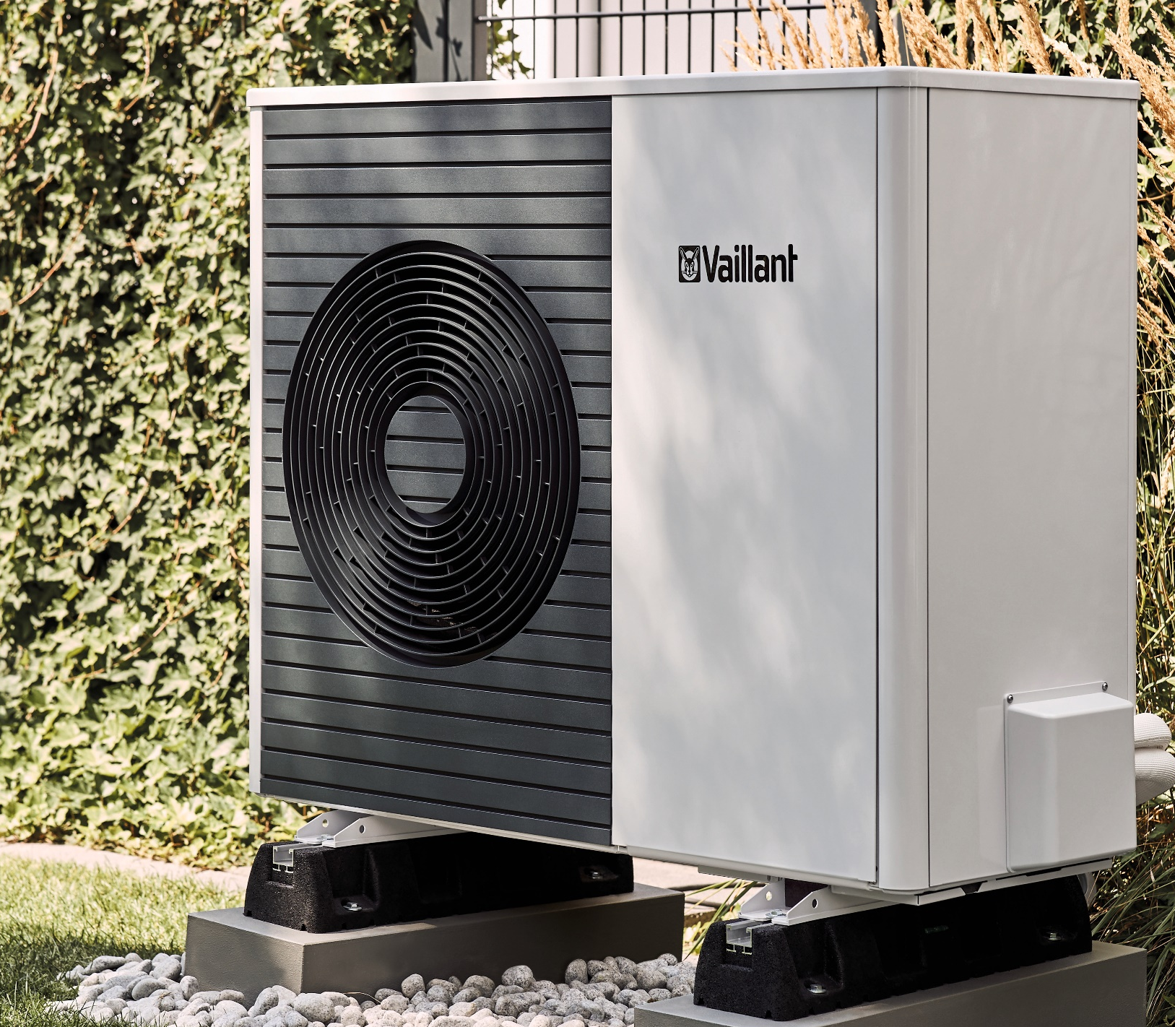
Congratulations on your new Vaillant Heat Pump
Guarantee and Servicing of Your Heat Pump
To ensure you get the best performance from your Heat Pump its important to have it serviced annually.
Up to 10 years manufacturers guarantee now available
Speak to our aftersales team today to discuss our packages.
For over 140 years, Vaillant has been a technology leader when it comes to innovative heating solutions and with a combined highly skilled Heat Pump Service Team, our servicing packages are designed to give you peace of mind.
Need expert on site advice and support regarding your new Vaillant Heat Pump ?
Every Heat Pump support package includes an onsite function check carried out by one of expert engineers.
Our Appliance function checks include:
Full visual checks
Temperature checks
System checks (visual and diagnose)
All relevant pipework pressure tested
Test for leaks
Test electrical circuits
Professional advice on system set up and product use
For further information and to speak with out expert team -
Call us on : 0330 1003540 - Monday – Friday between 08:00 – 17:00
Email : aftersales-uk@vaillant-group.com

Slide 5
Description | Annual Service appliance only | Annual Service inc System checks | Appliance function Check (One Off) | Connection Split & Appliance Function check
Appliance clearances and positioning | ✓ | ✓ | ✓ | ✓
Check installation meets protection zone dimensions | ✓ | ✓ | ✓ | ✓
Check suitability of anti-vibration measures | ✓ | ✓ | ✓ | ✓
Clear evaporator from build up of debris (leaves etc) | ✓ | ✓
Check refrigerant circuit for signs of leaks (oil Residue, Schrader caps secure, etc.) | ✓ | ✓ | ✓ | ✓
Check water side for signs of leaks | ✓ | ✓ | ✓ | ✓
Check condensate pipework, insulation and trace heater | ✓ | ✓ | ✓ | ✓
Check external pipework is insulated | ✓ | ✓ | ✓ | ✓
Inspect, clean and re-fit covers (fan blades, etc.) | ✓ | ✓ |  | ✓
Check support for refrigerant pipework | ✓ (split only) | ✓ (split only) |  | ✓
Check refrigerant pipes insulation and check pipework lengths have been adhered to | ✓ (split only) | ✓ (split only) |  | ✓
Check oil trap has been installed | ✓ (split only) | ✓ (split only) |  | ✓
Create end termination between heat pump & indoor unit refrigeration circuit |  |  |  | ✓
Strength test of refrigeration pipework |  |  |  | ✓
Vacuum down of refrigeration circuit |  |  |  | ✓
Fill circuit with correct amount of refrigerant (15m of pipework included in unit)** |  |  |  | ✓
Hydraulic
Full visual check of pipework |  |  | ✓ | ✓
Check expansion vessel air pressure is correct |  | ✓ | ✓ | ✓
Check and clean of return filter |  | ✓ | ✓ | ✓
Check system pressure |  | ✓ | ✓ | ✓
Check circulating pump operation |  | ✓ | ✓ | ✓
Check termination of PRV |  | ✓ | ✓ | ✓
Check any none return or shut off valves |  | ✓ | ✓ | ✓
Check for any required de-airing valves |  | ✓ | ✓ | ✓
Check open volume sufficient for defrost (Buffer/bypass circuit) |  | ✓ | ✓ | ✓
Check back-up Heater (if installed) |  | ✓ | ✓ | ✓
Visual check on heating circuit, to check that Delta T is correct |  | ✓ | ✓ | ✓
Check cold water safety group connected correctly |  | ✓
Check legionella connections and settings |  | ✓
DHW differential temperature check |  | ✓ | ✓ | ✓
DHW cylinder specification |  | ✓ | ✓ | ✓
Water quality turbity Check |  | ✓ | ✓
Fernox water quality sample
Frost protection check |  | ✓ | ✓
Check glycol circuit de-aired |  | ✓ | ✓
Electrical
Check electrical connections and polarity | ✓ | ✓ | ✓ | ✓
Check hydraulic scheme and hydraulic diagram | ✓ | ✓ | ✓ | ✓
Check electrical wiring is correct as per wiring diagram | ✓ | ✓ | ✓ | ✓
Check correct RCD/MCB rating at consumer unit | ✓ | ✓ | ✓ | ✓
Check ebus wiring (sizing/polarity/separation) | ✓ | ✓ | ✓ | ✓
Check system controls and operation | ✓ | ✓ | ✓ | ✓
Check appliance sensors and readings | ✓ | ✓ | ✓ | ✓
Log of all settings | ✓ | ✓ | ✓ | ✓
Handover
Professional advice on use | ✓ | ✓ | ✓ | ✓
Program check | ✓ | ✓ | ✓ | ✓
Record energy tariff | ✓ | ✓ | ✓ | ✓
A full detailed description and pricing for our renewable support options are available through contacting our Renewables support team.
If you require any more information you can call us on: 0330 100 3540
Email: aftersales-uk@vaillant-group.com

Slide 6
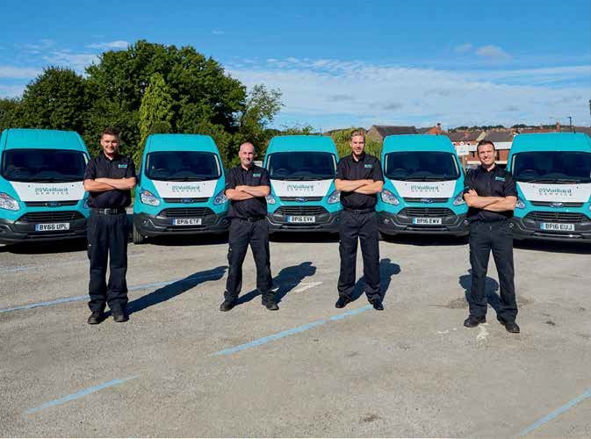


Our experience is your guarantee
For over 140 years, Vaillant has been among the technology leaders when it comes to innovative heating solutions and with a highly skilled Renewables Service Team, our servicing packages are designed to give you peace of mind.
Our packages include:
Full visual checks
Temperature checks
System checks (visual and diagnose)
All relevant pipework pressure tested
Test for leaks
Test electrical circuits
Professional advice on system set up and product use
For further information
Call us on : 0330 1003540
Email : aftersales-uk@vaillant-group.com
Lines are open 08:00 -17:30 Mon - Fri
Notes:
The intuitive app allows you to check, optimize and manage your smart heating system. At any time, from anywhere and with real-time information. Just the way you want it and with no additional costs.
Check the status of your smart heating system at a glance
Personal home screen informs you about the status of your heating system in real-time
Monitor your energy consumption easily
Be informed about changes via push notifications
Optimize your smart heating system without effort
Use smart features to improve the efficiency of your heating system
Integrate your heating system seamless into the overall smart home system
Weather adjusted heating demand, away modus set-up and temperature adjustments
Manage your personal comfort and energy consumption mindfully
Increase your family’s and your own personal comfort
Operate the system conveniently from anywhere and reduce costs and CO2 footprint
In case of a breakdown, your installer can check remotely what happened and inform you – usually before you even notice

