Slide 1


RESIDENTS USER GUIDE
Please note only defects can be reported through the portal. Please refer to your Newbuild Aftercare guide for examples of defects and timescales for repairs.
This system is only to be used for non urgent issues. Please contact us on the below telephone number if reporting an URGENT defect.
0330 175 9726
If you experience any difficulties in using this portal you can still report defects by contacting us on the below email address or telephone number.
newbuild-aftercare@poblgroup.co.uk
0330 175 9726

Slide 2

Contents
Your Portal 3
Home 4
What is a Ticket? 5
Creating a Ticket 6
Comments 7
Ticket Status 8
Discussions 9
Appointments 10

Slide 3

YOUR PORTAL
clixifix® enables you to centralise all your conversations with your developer.
Your Portal allows you to:
Log defects by creating a Ticket
Communicate with your house-builder directly
Add a comment which is time and date stamped
Track the progress of your ticket
View all confirmed Appointments
Your Portal may include the following:
Appliance Guides & important Handover Documents
Useful information (meter information, choices, etc.)
Information about your housebuilder and their customer care charter
Full details of your warranty provider

Slide 4
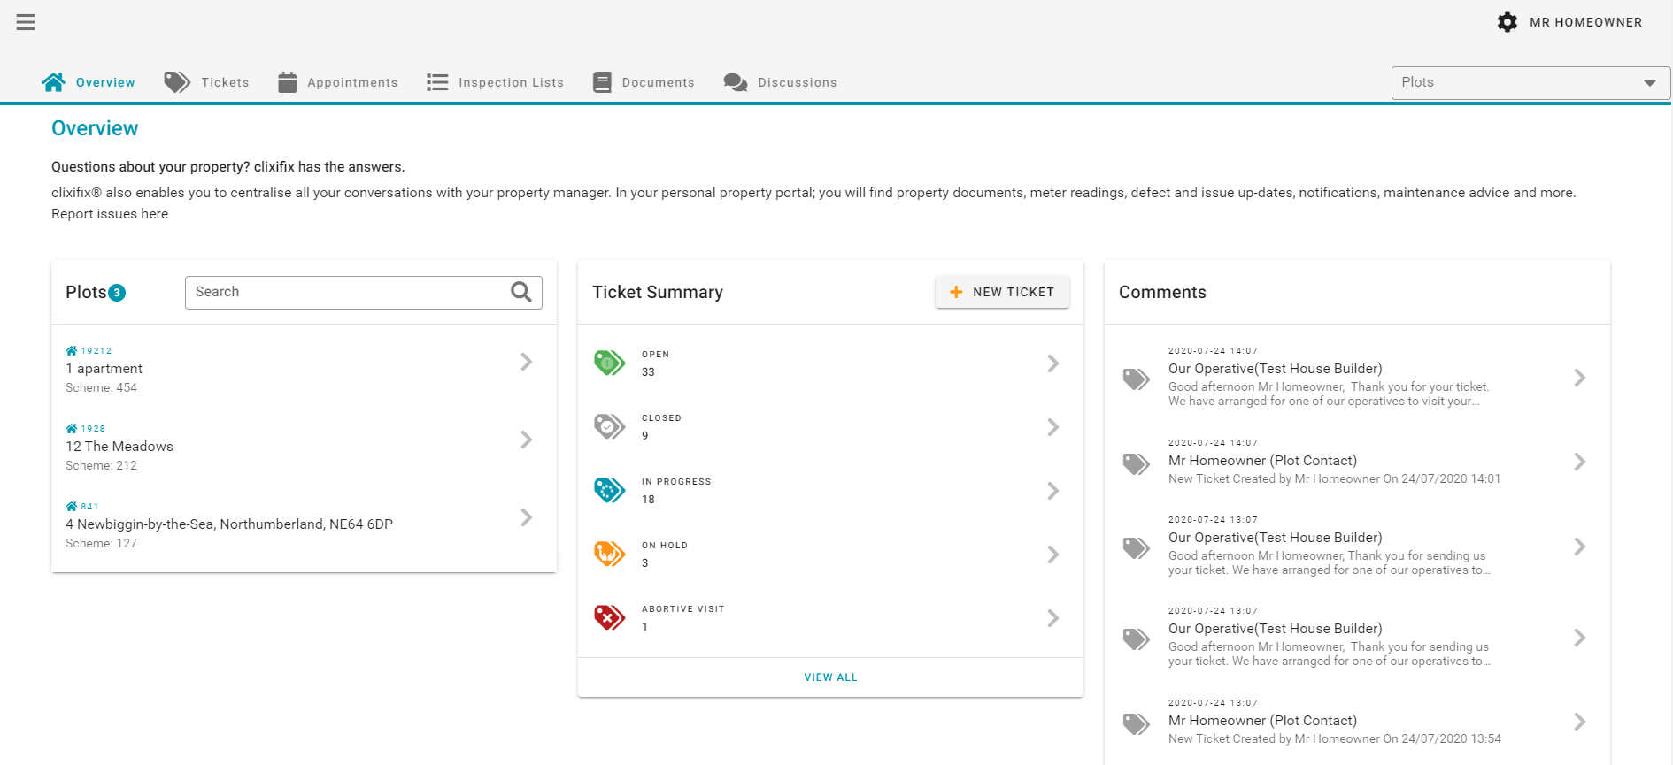
Overview
OVERVIEW
Your ‘Overview’ dashboard contains all the resources your housebuilder has pre-populated for you to help you with your new home.
✔ Plot(s) Information
✔ Ticket Summary
✔ Adding Ticket Shortcut
✔ Comments

Slide 5
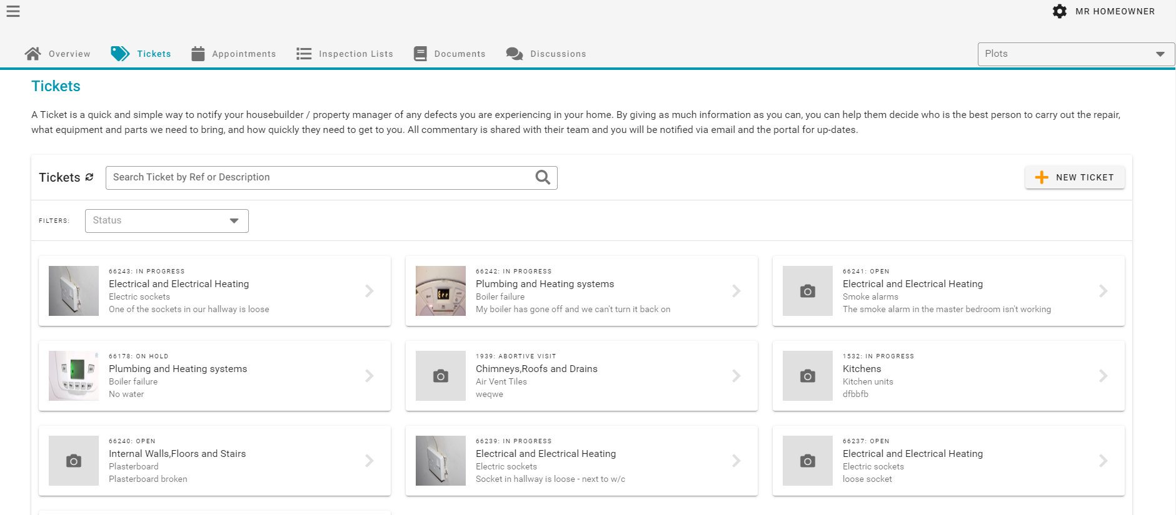
WHAT IS A TICKET?
What is a Ticket?
A Ticket is a quick and simple way to notify your housebuilder of any defects you are experiencing in your new home.
Tickets Tab
This section displays all Tickets relating to your property.

Slide 6
Creating a Ticket
CREATING A TICKET
3 Steps to Creating a Ticket:
New Ticket (one defect per ticket)
Defect Type & Sub-category (with detailed description)
Other Comments (access information etc.)

Slide 7
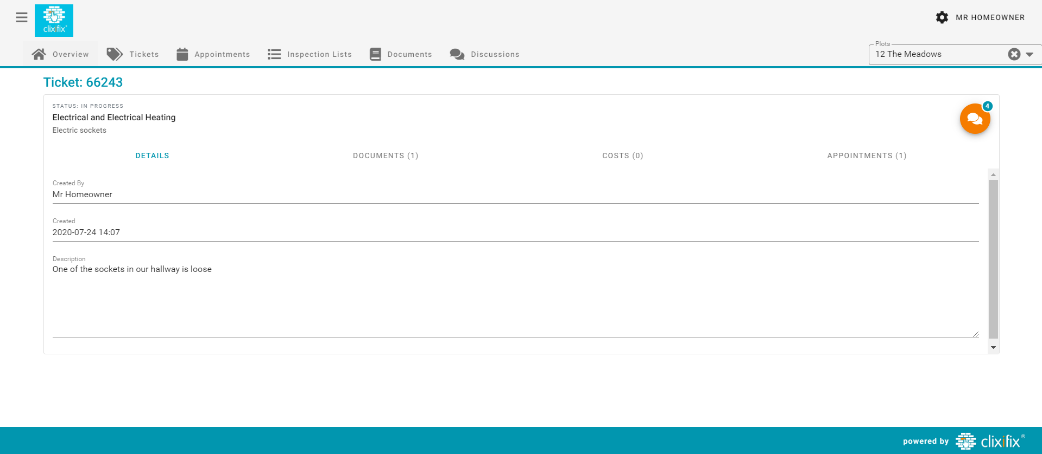
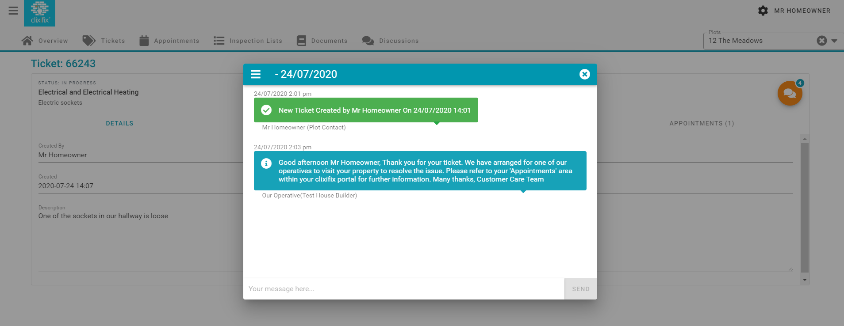
Comments
OVERVIEW
Comments
Now you have created your ticket, you have an open line of communication with your housebuilder regarding your reported defect via the Comments Tab.
Simply Add a Comment to:
Liaise with your housebuilder regarding appointments
Request an update
Inform your housebuilder of any changes to your defect (i.e. the problem has worsened)

Slide 8
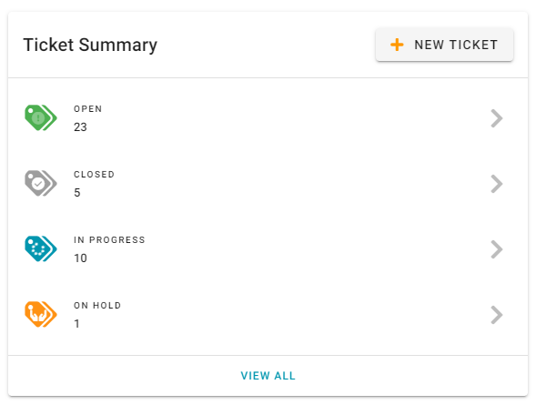
Ticket Status
TICKET STATUS
There are 4 possible Status levels for Tickets:
Open – Your Ticket has been raised successfully and your housebuilder has been notified
Closed – The Ticket has been resolved
In Progress – Your housebuilder is working to resolve the defect
On Hold – Your Ticket has been placed on hold. This could be for a number of reasons (e.g. a part requires manufacturing)
Status

Slide 9
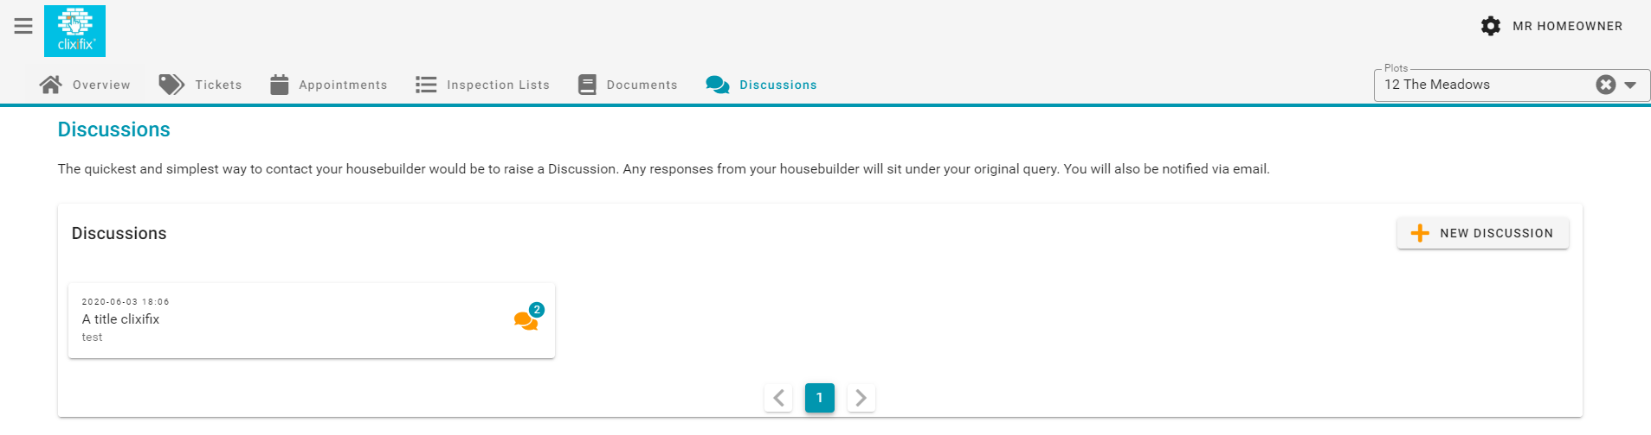
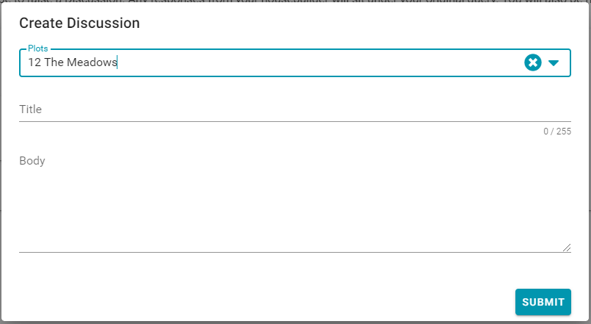
Discussions
DISCUSSIONS
You may have a general enquiry about your new home.
The quickest and simplest way to contact your housebuilder would be to raise a Discussion.
Discussions
How to create a Discussion:
Title (e.g. Paint Query)
Detail (e.g. what is the colour of my living room paint?)
Add file (if applicable)
Submit
Any responses from your housebuilder will sit under your original query. You will also be notified via email.

Slide 10
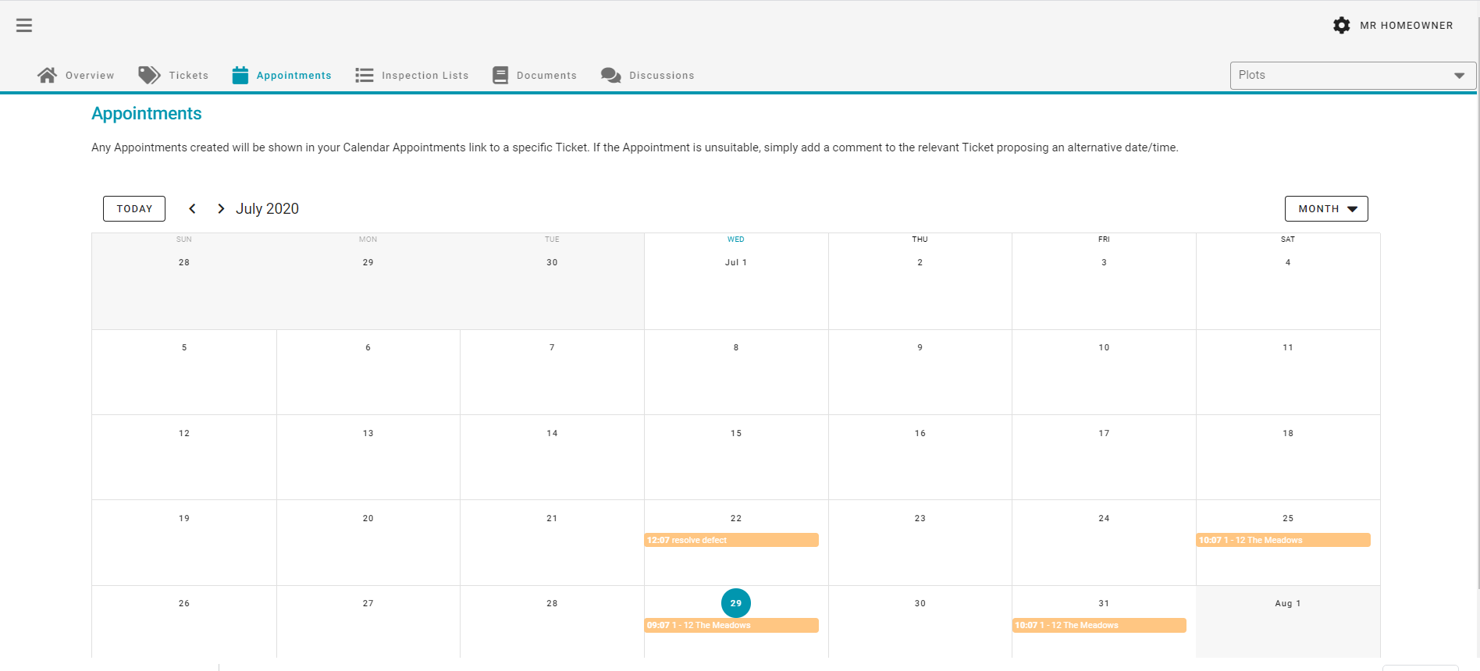
Appointments
APPOINTMENTS
Any Appointments created will be shown in the Appointments area of your portal
Appointments link to a specific Ticket
If the Appointment is unsuitable, simply add a comment to the relevant Ticket proposing an alternative date/time

